Slide 1

ETL System for Sales, Customer, Product & Inventory Management​
SSIS-based Data Warehouse Solution​

Slide 2



Problem Statement​
No Automated Ingestion​
Missing Historical Tracking​
Inconsistent Reporting​
Manual daily data processes.​
Inability to analyze trends over time.​
Manual processes lead to unreliable data and reports.​

Slide 3
Project Objectives: Automating Data Excellence
Automated Flat File Extraction
Data Transformation & Staging
Seamless data extraction from diverse flat file sources.
Transforming raw data with essential metadata for staging, dimensions, and fact tables.
Incremental Loading
Historical Tracking
Full SCD Type 2/CDC for Customer and Product dimensions.
Efficiently update sales data.
Inventory Management​
Robust Error Handling
Daily BOH/EOH calculations.​
Implement comprehensive logging and graceful error management.

Slide 4

Tools and Technologies Utilised
Core Technologies
Implementation Details
ETL Tool: SQL Server Integration Services (SSIS)
Transformation Logic: SSIS Derived Columns, Data Flow, Control Flow
Database: SQL Server (VORTEX\SQLEXPRESS.Project.sa)
Database Objects: Stored Procedures (insert_dim_customer, insert_dim_product, LOAD_INVENTORY)
Functions: Scalar function USDToNPR() for currency conversion

Slide 5



Data Architecture: Flow and Structure
Input Data
Staging Tables
Data Warehouse
Daily CSV files (Customers, Products, Sales) from configurable paths.
stg_customers, stg_products, stg_sales; truncated and loaded via Foreach Loops.
DimCustomer, DimProduct (SCD Type 2)
FactSales (Incremental)
InventoryDaily (BOH/EOH tracking)
etl_audit (Logging)

Slide 6
ETL Workflow: The Implementation Plan
01
02
03
Phase 1: Retrieve Last ETL Run Date
Phase 2: Truncate Staging Tables
Phase 3: Process CSV Files
Ingest customer, product, and sales data from respective CSV files.
Dynamically determine the starting point for incremental loads.
Prepare staging area for fresh data ingestion.
04
05
Phase 4: Load Staging Tables
Phase 5: Merge Dimensions
​
Apply MERGE logic for dim_customer and dim_product (SCD2) to track
historical data and changes
Populate temporary staging tables with extracted data.
06
07
Phase 6: Incremental Sales Load​
​
Phase 7: Run Inventory Calculation
​​
​
FactSales loads records newer than lastrundate frometl_audit.
Execute daily inventory BOD/EOD calculations.
08
09
Phase 8: Log Results
​​
​
Phase 9: File Archival
​​
​
Record ETL outcomes in etl_audit.
Automatically moves processed files, maintaining a clean source directory.

Slide 7




Key Logic Implementation
SCD Type 2
SQL MERGE statements for historical tracking and attribute changes.
Incremental Load
FactSales loads records newer than lastrundate from etl_audit.
Financial Transformation
Price conversion via USDToNPR scalar function.
Inventory Logic
Custom BOH/EOH calculation in LOAD_INVENTORY procedure.
Inventory Logic
Custom BOH/EOH calculation in LOAD_INVENTORY procedure.

Slide 8







Design & Development: Building the ETL Flow
Dynamic File Paths
Foreach Loop Container
Derived Column Transformation
Adding metadata and performing data manipulations.
Using SSIS variables for flexible file location management.
Iterating through files for each data feed (customer, product, sales).
OLE DB Destination
MERGE Logic for SCD2
Incremental Fact Sales Load
Efficiently loading data into staging tables.
Handling inserts, updates, and end-dating for dim_customer & dim_product.
Utilising lastrundate for efficient fact_sales updates.
LOAD_INVENTORY Procedure
Dedicated procedure for daily BOD/EOD inventory calculations.

Slide 9
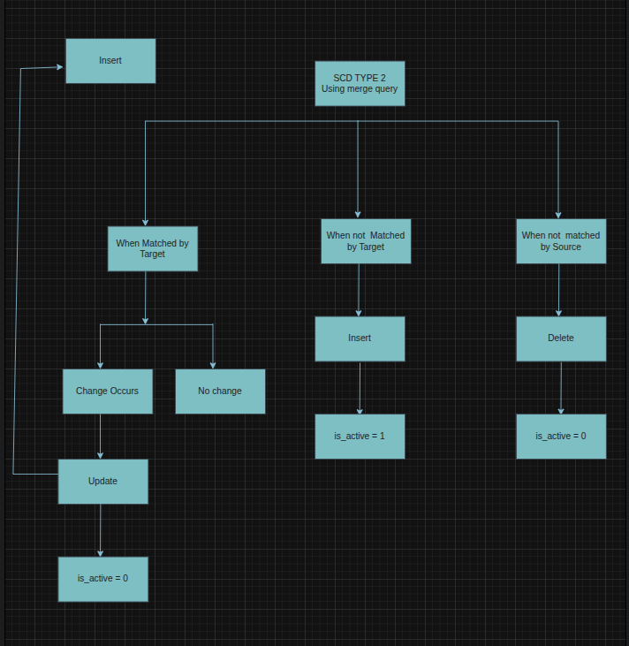
SCD Type 2 Logic

Slide 10
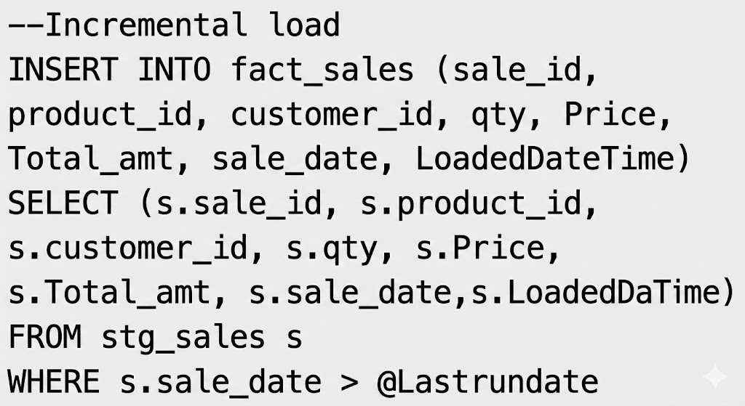

Fact Logic
Inventory Logic
Fact Sales
Inventory
Incremental load only.
Calculated daily.
USD to NPR conversion for all prices.
Beginning-of-Hand (BOH).
End-of-Hand (EOH).

Slide 11

Testing & Validation: Ensuring Data Quality
File Ingestion
Verified correct processing of source CSV files.
SCD2 Logic
Validated inserts, updates, and proper end-dating for dimension tables.
Incremental Sales
Confirmed accurate incremental loading without duplicate entries.
Currency Conversion
Checked the accuracy of USD to NPR conversions.
Daily Inventory
Tested correct BOD/EOD inventory output.
Logging & Error Handling
Ensured comprehensive logging of success and failure scenarios.

Slide 12

Challenges Faced: Overcoming Obstacles
Dynamic File Paths
MERGE Conflicts
Implementing flexible solutions for varying file locations.
Debugging and optimising MERGE statements for dimension table consistency.
CSV Format Inconsistencies
SCD2 Row Duplication
Handling diverse and sometimes erroneous source file formats.
Ensuring uniqueness and correct history tracking in SCD2 dimensions.
Inventory Logic
Maintaining accurate BOD/EOD inventory calculations.

Slide 13




Learnings & Improvements: Evolving the Process
Enhanced SCD Type-2 Mastery
Deeper understanding and application of SCD Type-2 principles.
SSIS Event Handlers
Using event handlers to track activity and handle errors better.
Optimized Table Design
Improved design for staging and fact tables for better performance.
Next Steps: Data Validation & Alerts
Future integration of data validation rules and automated email alerts.

Slide 14
Conclusion: A Fully Automated ETL Pipeline
End-to-End Automation
SCD2 Dimensions
Fully automated ETL pipeline operational.
Historical tracking for customer and product data.
Incremental Fact Loading
Daily Inventory
Efficient and performant sales data updates.
Accurate and timely inventory reporting.
Integrated Audit Logging
Full traceability and monitoring of ETL runs.

